Slide 1
Inference in First-Order Logic
CHAPTER 9
Oliver Schulte

Slide 2
Outline
Reducing first-order inference to propositional inference
Unification
Lifted Resolution

Slide 3
Basic Setup
We focus on a set of 1st-order clauses.
All variables are universally quantified.
Many knowledge bases can be converted to this format.
Existential quantifiers are eliminated using function symbols
  Quantifier elimination, Skolemization.
Example UBC Prolog Demo

Slide 4
Two Basic Ideas for Inference in FOL
Grounding:
  Treat first-order sentences as a template.
  Instantiating all variables with all possible constants gives a set of ground propositional clauses.
  Apply efficient propositional solvers, e.g. SAT.
Lifted Inference:
  Generalize propositional methods for 1st-order methods.
  Unification: recognize instances of variables where necessary.

Slide 5
Universal instantiation (UI)
Notation: Subst({v/g}, α) means the result of substituting g for v in sentence α
Every instantiation of a universally quantified sentence is entailed by it:
∀v α
Subst({v/g}, α)
for any variable v and ground term g
E.g., ∀x King(x) ∧ Greedy(x) ⇒ Evil(x) yields
  King(John) ∧ Greedy(John) ⇒ Evil(John), {x/John}
  King(Richard) ∧ Greedy(Richard) ⇒ Evil(Richard), {x/Richard}
  King(Father(John)) ∧ Greedy(Father(John)) ⇒ Evil(Father(John)), {x/Father(John)}

Slide 6
Existential instantiation (EI)
For any sentence α, variable v, and constant symbol k (that does not appear elsewhere in the knowledge base):
∃v α
Subst({v/k}, α)
E.g., ∃x Crown(x) ∧ OnHead(x,John) yields: Crown(C₁) ∧ OnHead(C₁,John)
where C₁ is a new constant symbol, called a Skolem constant
Existential and universal instantiation allows to “propositionalize” any FOL sentence or KB
  EI produces one instantiation per EQ sentence
  UI produces a whole set of instantiated sentences per UQ sentence

Slide 7
Reduction to propositional form
Suppose the KB contains the following:
  ∀x King(x) ∧ Greedy(x) ⇒ Evil(x)
  Father(x)
  King(John)
  Greedy(John)
  Brother(Richard,John)
Instantiating the universal sentence in all possible ways, we have:
  King(John) ∧ Greedy(John) ⇒ Evil(John)
  King(Richard) ∧ Greedy(Richard) ⇒ Evil(Richard)
  King(John)
  Greedy(John)
  Brother(Richard,John)
The new KB is propositionalized: propositional symbols are
  King(John), Greedy(John), Evil(John), King(Richard), etc

Slide 8
Reduction continued
Every FOL KB can be propositionalized so as to preserve entailment
  A ground sentence is entailed by new KB iff entailed by original KB
Idea for doing inference in FOL:
  propositionalize KB and query
  apply resolution-based inference
  return result
Problem: with function symbols, there are infinitely many ground terms,
  e.g., Father(Father(Father(John))), etc

Slide 9
Reduction continued
Theorem: Herbrand (1930). If a sentence α is entailed by a FOL KB, it is entailed by a finite subset of the propositionalized KB
  create a propositional KB by instantiating with depth-$n$ terms
  see if α is entailed by this KB
Example
  ∀x King(x) ∧ Greedy(x) ⇒ Evil(x)
  Father(x)
  King(John)
  Greedy(Richard)
  Brother(Richard,John)
Query Evil(X)?
Idea: For n = 0 to ∞ do

Slide 10
Depth 0
  Father(John)
  Father(Richard)
  King(John)
  Greedy(Richard)
  Brother(Richard , John)
  King(John) ∧ Greedy(John) ⇒ Evil(John)
  King(Richard) ∧ Greedy(Richard) ⇒ Evil(Richard)
  King(Father(John)) ∧ Greedy(Father(John)) ⇒ Evil(Father(John))
  King(Father(Richard)) ∧ Greedy(Father(Richard)) ⇒ Evil(Father(Richard))
Depth 1
  Depth 0 +
  Father(Father(John))
  Father(Father(John))
  King(Father(Father(John))) ∧ Greedy(Father(Father(John))) ⇒ Evil(Father(Father(John)))

Slide 11
Issues with Propositionalization
Problem: works if α is entailed, loops if α is not entailed
Propositionalization generates lots of irrelevant sentences
  So inference may be very inefficient. E.g., consider KB
  ∀x King(x) ∧ Greedy(x) ⇒ Evil(x)
  King(John)
  ∀y Greedy(y)
  Brother(Richard,John)
  It seems obvious that Evil(John) is entailed, but propositionalization produces lots of facts such as Greedy(Richard) that are irrelevant.
  Approach: Magic Set Rewriting, from deductive databases.
With p k-ary predicates and n constants, there are p·n^{k} instantiations.
  Current Research, Mitchell and Ternovska SFU.
Alternative: do inference directly with FOL sentences

Slide 12
Unification
Recall: Subst(θ, p) = result of substituting θ into sentence p
Unify algorithm: takes 2 sentences p and q and returns a unifier if one exists
Unify(p,q) = θ where Subst(θ, p) = Subst(θ, q)
Example:
p = Knows(John,x)
q = Knows(John, Jane)
Unify(p,q) = {x/Jane}

Slide 13
Unification examples
simple example: query = Knows(John,x), i.e., who does John know?
p q θ
Knows(John,x) Knows(John,Jane) {x/Jane}
Knows(John,x) Knows(y,OJ) {x/OJ,y/John}
Knows(John,x) Knows(y,Mother(y)) {y/John,x/Mother(John)}
Knows(John,x) Knows(x,OJ) {fail}
Last unification fails: only because x can’t take values John and OJ at the same time
Problem is due to use of same variable x in both sentences
Simple solution: Standardizing apart eliminates overlap of variables, e.g., Knows(z,OJ)

Slide 14
Unification
To unify Knows(John,x) and Knows(y,z),
θ = {y/John, x/z } or θ = {y/John, x/John, z/John}
The first unifier is more general than the second.
Theorem: There is a single most general unifier (MGU) that is unique up to renaming of variables.
  MGU = { y/John, x/z }
General algorithm in Figure 9.1 in the text

Slide 15
Recall our example…
  King(John)
  ∀y Greedy(y)
  Brother(Richard,John)
  We would like to infer Evil(John) without propositionalization.
  Basic Idea: Use Modus Ponens, Resolution when literals unify.
x King(x)  Greedy(x)  Evil(x)

Slide 16
Generalized Modus Ponens (GMP)
p₁', p₂', … , p_{n}', ( p₁ ∧ p₂ ∧ … ∧ p_{n} ⇒q)
Subst(θ,q)
Example:
p₁' is King(John) p₁ is King(x)
p₂' is Greedy(John) p₂ is Greedy(x)
θ is {x/John} q is Evil(x)
Subst(θ,q) is Evil(John)
King(John), Greedy(John) ,x King(x)  Greedy(x)  Evil(x)
where we can unify p_{i}‘ and p_{i} for all i
Evil(John)

Slide 17
Completeness and Soundness of GMP
GMP is sound
  Only derives sentences that are logically entailed
  See proof in Ch.9.5.4. of the text.
GMP is complete for a 1st-order KB in Horn Clause format.
  Complete: derives all sentences that entailed.

Slide 18
Logic programming: Prolog
Program = set of clauses = head :- literal₁, … literal_{n}.
criminal(X) :- american(X), weapon(Y), sells(X,Y,Z), hostile(Z).
Missile(m1).
Sells(west,X,nono):- Missile(X) Owns(nono,X).
weapon(X):- missile(X).
hostile(X) :- enemy(X,america).
american(west)
Query : criminal(west)?
Query: criminial(X)?
Owns(nono,m1).

Slide 19
membership
  member(X,[X|_]).
  member(X,[_|T]):- member(X,T).
    ?-member(2,[3,4,5,2,1])
    ?-member(2,[3,4,5,1])
subset
  subset([],L).
  subset([X|T],L):- member(X,L),subset(T,L).
    ?- subset([a,b],[a,c,d,b]).
Nth element of list
  nth(0,[X|_],X).
  nth(N,[_|T],R):- nth(N-1,T,R).
    ?nth(2,[3,4,5,2,1],X)

Slide 20
Proof Search in Prolog
As in the propositional case, can do a depth-first or breadth-first search + unification.
See UBC definite clause tool for demonstration.

Slide 21
Resolution in FOL
Full first-order version:
l₁ ∨ ··· ∨ l_{k}, m₁ ∨ ··· ∨ m_{n}
Subst(θ , l₁ ∨ ··· ∨ l_{i-1} ∨ l_{i+1} ∨ ··· ∨ l_{k} ∨ m₁ ∨ ··· ∨ m_{j-1} ∨ m_{j+1} ∨ ··· ∨ m_{n})
where Unify(l_{i}, ¬m_{j}) = θ.
The two clauses are assumed to be standardized apart so that they share no variables.
For example,
¬Rich(x) ∨ Unhappy(x) Rich(Ken)
Unhappy(Ken)
with θ = {x/Ken}
Apply resolution steps to CNF(KB ∧ ¬α); complete for FOL.
  Gödel’s completeness theorem.

Slide 22



Horn Clauses
Resolution in general can be exponential in space and time.
If we can reduce all clauses to “Horn clauses” resolution is linear in space and time
A clause with at most 1 positive literal.
e.g.
Every Horn clause can be rewritten as an implication with
a conjunction of positive literals in the premises and a single
positive literal as a conclusion.
e.g.
1 positive literal: definite clause
0 positive literals: Fact or integrity constraint:
e.g.

Slide 23
Soundness of GMP
Need to show that
p₁', …, p_{n}', (p₁ ∧ … ∧ p_{n} ⇒ q) ╞ qθ
provided that p_{i}'θ = p_{i}θ for all I
Lemma: For any sentence p, we have p ╞ pθ by UI
  (p₁ ∧ … ∧ p_{n} ⇒ q) ╞ (p₁ ∧ … ∧ p_{n} ⇒ q)θ = (p₁θ ∧ … ∧ p_{n}θ ⇒ qθ)
  p₁', \; …, \;p_{n}' ╞ p₁' ∧ … ∧ p_{n}' ╞ p₁'θ ∧ … ∧ p_{n}'θ
  From 1 and 2, qθ follows by ordinary Modus Ponens

Slide 24
Storage and retrieval
Storage(s): stores a sentence s into the knowledge base
Fetch(q): returns all unifiers such that the query q unifies with some sentence.
Simple naïve method. Keep all facts in knowledge base in one long list and then call unify(q,s) for all sentences to do fetch.
  Inefficient but works
Unification is only attempted on sentence with chance of unification. (knows(john, x) , brother(richard,john))
  Predicate indexing
  If many instances of the same predicate exist (tax authorities employer(x,y))
    Also index arguments
    Keep latice p280

Slide 25
Inference appoaches in FOL
Forward-chaining
  Uses GMP to add new atomic sentences
  Useful for systems that make inferences as information streams in
  Requires KB to be in form of first-order definite clauses
Backward-chaining
  Works backwards from a query to try to construct a proof
  Can suffer from repeated states and incompleteness
  Useful for query-driven inference
Resolution-based inference (FOL)
  Refutation-complete for general KB
    Can be used to confirm or refute a sentence p (but not to generate all entailed sentences)
  Requires FOL KB to be reduced to CNF
  Uses generalized version of propositional inference rule
Note that all of these methods are generalizations of their propositional equivalents

Slide 26
Knowledge Base in FOL
The law says that it is a crime for an American to sell weapons to hostile nations. The country Nono, an enemy of America, has some missiles, and all of its missiles were sold to it by Colonel West, who is American.
Exercise: Formulate this knowledge in FOL.

Slide 27
Knowledge Base in FOL
The law says that it is a crime for an American to sell weapons to hostile nations. The country Nono, an enemy of America, has some missiles, and all of its missiles were sold to it by Colonel West, who is American.
... it is a crime for an American to sell weapons to hostile nations:
  American(x) ∧ Weapon(y) ∧ Sells(x,y,z) ∧ Hostile(z) ⇒ Criminal(x)
Nono … has some missiles, i.e., ∃x Owns(Nono,x) ∧ Missile(x):
Owns(Nono,M₁) and Missile(M₁)
… all of its missiles were sold to it by Colonel West
  Missile(x) ∧ Owns(Nono,x) ⇒ Sells(West,x,Nono)
Missiles are weapons:
An enemy of America counts as "hostile“:
Enemy(x,America) ⇒ Hostile(x)
West, who is American …
American(West)
The country Nono, an enemy of America …
Enemy(Nono,America)
Missile(x)  Weapon(x)

Slide 28
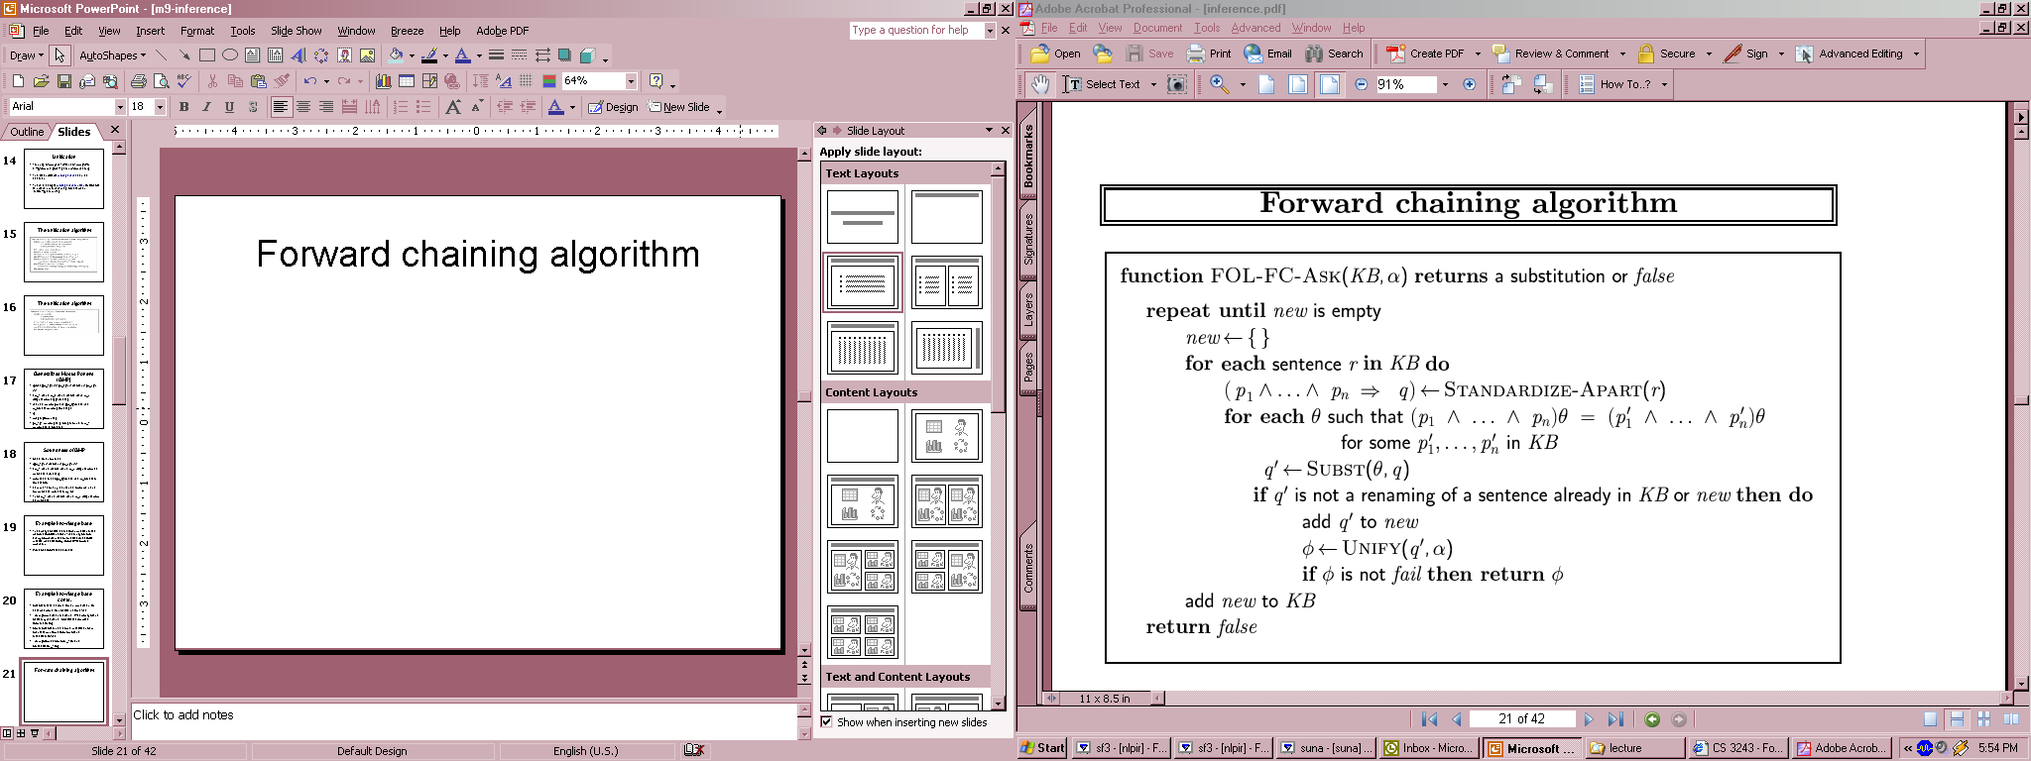
Forward chaining algorithm
Definite clauses → disjunctions of literals of which exactly one is positive.
  P1 , p2, p3 → q
Is suitable for using GMP

Slide 29
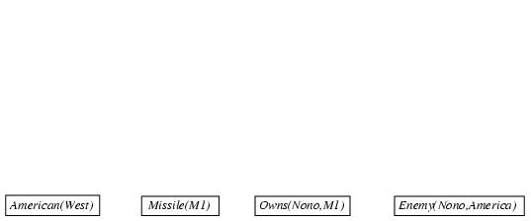
Forward chaining proof

Slide 30
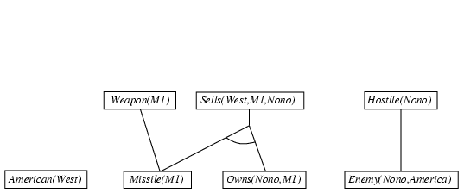
Forward chaining proof

Slide 31
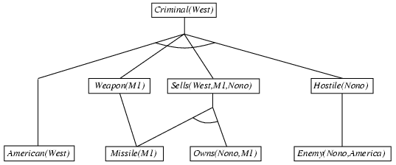
Forward chaining proof

Slide 32
Properties of forward chaining
Sound and complete for first-order definite clauses
Datalog = first-order definite clauses + no functions
FC terminates for Datalog in finite number of iterations
May not terminate in general if α is not entailed

Slide 33
Efficiency of forward chaining
Incremental forward chaining: no need to match a rule on iteration k if a premise wasn't added on iteration k-1
  ⇒ match each rule whose premise contains a newly added positive literal
Matching itself can be expensive:
Database indexing allows O(1) retrieval of known facts
  e.g., query Missile(x) retrieves Missile(M₁)
Forward chaining is widely used in deductive databases

Slide 34

Hard matching example
Diff(wa,nt) ∧ Diff(wa,sa) ∧ Diff(nt,q) ∧ Diff(nt,sa) ∧ Diff(q,nsw) ∧ Diff(q,sa) ∧ Diff(nsw,v) ∧ Diff(nsw,sa) ∧ Diff(v,sa) ⇒ Colorable()
Diff(Red,Blue) Diff (Red,Green) Diff(Green,Red) Diff(Green,Blue) Diff(Blue,Red) Diff(Blue,Green)
Colorable() is inferred iff the CSP has a solution
CSPs include 3SAT as a special case, hence matching is NP-hard

Slide 35
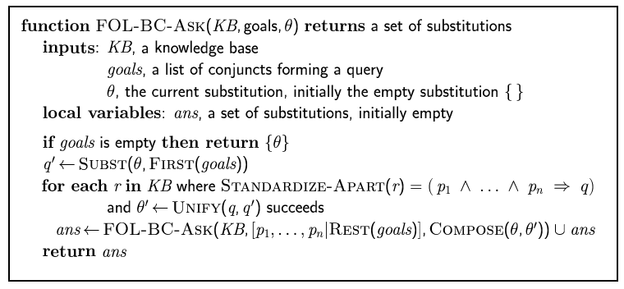
Backward chaining algorithm

Slide 36

Backward chaining example

Slide 37
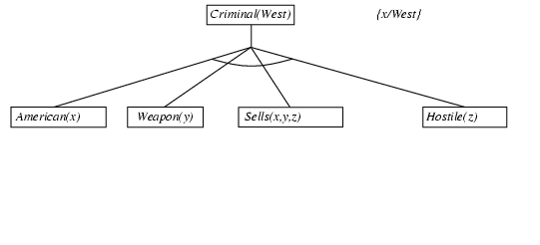
Backward chaining example

Slide 38
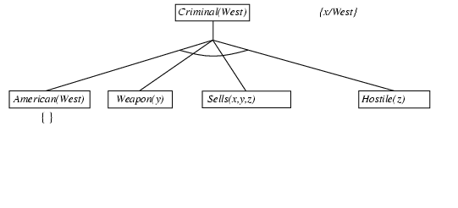
Backward chaining example

Slide 39
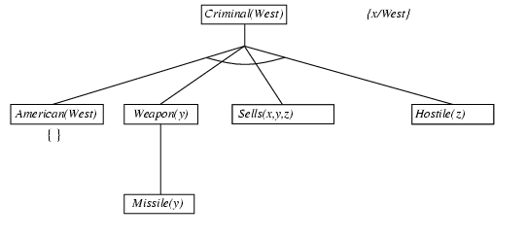
Backward chaining example

Slide 40
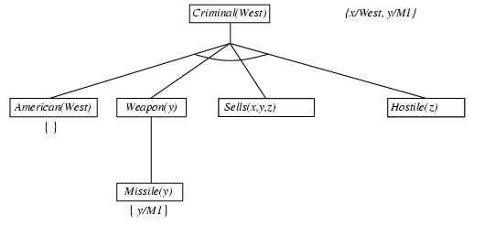
Backward chaining example

Slide 41
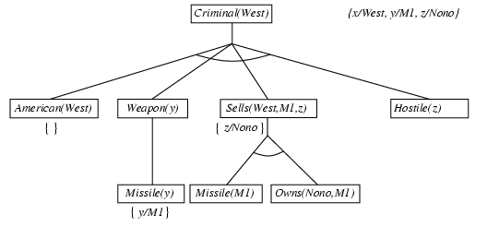
Backward chaining example

Slide 42
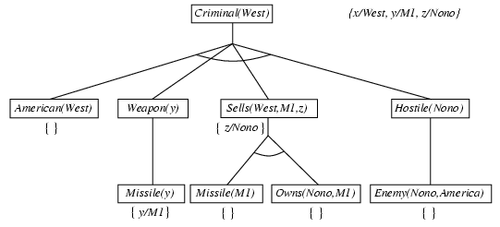
Backward chaining example

Slide 43
Backward chaining example

Slide 44
Properties of backward chaining
Depth-first recursive proof search: space is linear in size of proof
Incomplete due to infinite loops
  ⇒ fix by checking current goal against every goal on stack
Inefficient due to repeated subgoals (both success and failure)
  ⇒ fix using caching of previous results (extra space)
Widely used for logic programming

Slide 45
Prolog
Appending two lists to produce a third:
  append([],Y,Y).
  append([X|L],Y,[X|Z]) :- append(L,Y,Z).
    query: append([1,2],[3],Z) ?
    query: append(A,B,[1,2]) ?
answers: A=[] B=[1,2]
A=[1] B=[2]
Path between two nodes in a graph
  path(X,Z): link(X,Z)
  path(X,Z): link(Y,Z), path(X,Y)
What happens if?
path(X,Z): path(X,Y), link(X,Z)
path(X,Z): link(X,Z)
A=[1,2] B=[]

Slide 46
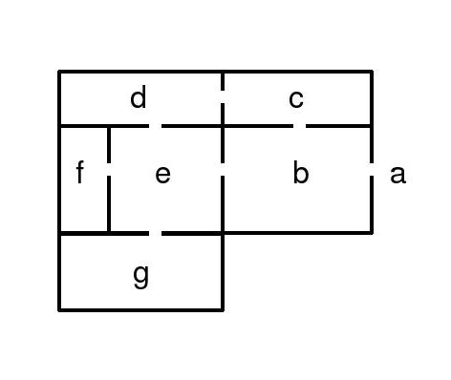
Searching in a Maze
Searching for a telephone in a building:
How do you search without getting lost?
How do you know that you have searched the whole building?
What is the shortest path to the telephone?

Slide 47
Searching in a Maze
go(X,Y,T): Succeeds if one can go from room X to room Y. T contains the list of rooms visited so far.
Facts in the knowledge base
  Door(b,c)
  hasphone(g):
go(X,X,_).
go(X,Y,T) :- door(X,Z), not(member(Z,T)), go(Z,Y,[Z|T]).
go(X,Y,T) :- door(Z,X), not(member(Z,T)), go(Z,Y,[Z|T]).
go(a,X,[]),hasphone(X) inefficient.
hasphone(X),go(a,X,[])

Slide 48
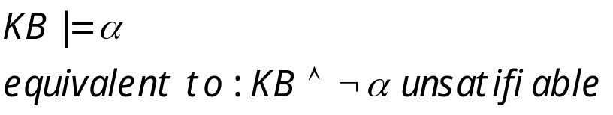

Recall: Propositional Resolution-based Inference
We want to prove:
We first rewrite into conjunctive normal form (CNF).
literals
A “conjunction of disjunctions”
(A ∨ ¬B) ∧ (B ∨ ¬C ∨ ¬D)
Clause
Clause
Any KB can be converted into CNF
k-CNF: exactly k literals per clause

Slide 49
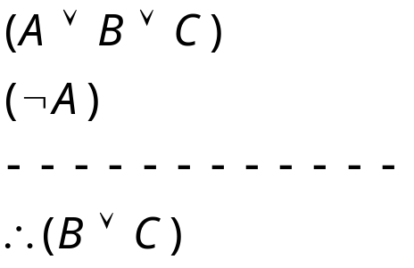
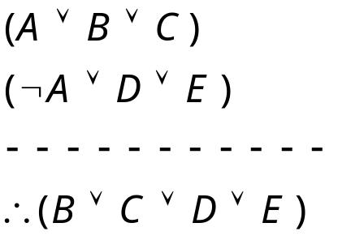
Resolution Examples (Propositional)

Slide 50
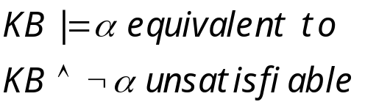


Resolution Algorithm
The resolution algorithm tries to prove:
Generate all new sentences from KB and the query.
One of two things can happen:
We find which is unsatisfiable,
i.e. we can entail the query.
2. We find no contradiction: there is a model that satisfies the
  Sentence (non-trivial) and hence we cannot entail the query.

Slide 51

Resolution example
KB = (B_{1,1} ⇔ (P_{1,2}∨ P_{2,1})) ∧¬ B_{1,1}
α = ¬P_{1,2}
True
False in
all worlds

Slide 52
Example Knowledge Base in FOL (Hassan)
... it is a crime for an American to sell weapons to hostile nations:
  American(x) ∧ Weapon(y) ∧ Sells(x,y,z) ∧ Hostile(z) ⇒ Criminal(x)
Nono … has some missiles, i.e., ∃x Owns(Nono,x) ∧ Missile(x):
  Owns(Nono,M₁) and Missile(M₁)
… all of its missiles were sold to it by Colonel West
  Missile(x) ∧ Owns(Nono,x) ⇒ Sells(West,x,Nono)
Missiles are weapons:
  Missile(x) ⇒ Weapon(x)
An enemy of America counts as "hostile“:
  Enemy(x,America) ⇒ Hostile(x)
West, who is American …
  American(West)
The country Nono, an enemy of America …
  Enemy(Nono,America)
  Can be converted to CNF
  Query: Criminal(West)?
Notes:
Hassan stopped here

Slide 53
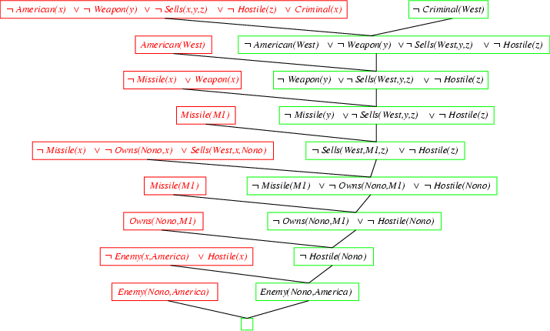
Resolution proof
Notes:
Last step is missing a negation sign on the green part.

Slide 54
Converting FOL sentences to CNF
Original sentence:
Anyone who likes all animals is loved by someone:
  ∀x [∀y Animal(y) ⇒ Likes(x,y)] ⇒ [∃y Loves(y,x)]
1. Eliminate biconditionals and implications
  ∀x [¬∀y ¬Animal(y) ∨ Likess(x,y)] ∨ [∃y Loves(y,x)]
2. Move ¬ inwards:
Recall: ¬∀x p ≡ ∃x ¬p, ¬ ∃x p ≡ ∀x ¬p
  ∀x [∃y ¬(¬Animal(y) ∨ Likes(x,y))] ∨ [∃y Loves(y,x)]
  ∀x [∃y ¬¬Animal(y) ∧ ¬Likes(x,y)] ∨ [∃y Loves(y,x)]
  ∀x [∃y Animal(y) ∧ ¬Likes(x,y)] ∨ [∃y Loves(y,x)]
  Either there is some animal that x doesn’t like if that is not the case then someone loves x

Slide 55
Conversion to CNF contd.
Standardize variables: each quantifier should use a different one
  ∀x [∃y Animal(y) ∧ ¬Likes(x,y)] ∨ [∃z Loves(z,x)]
Skolemize:
∀x [Animal(A) ∧ ¬Likes(x,A)] ∨ Loves(B,x)
  Everybody fails to love a particular animal A or is loved by a particular person B
  Animal(cat)
  Likes(marry, cat)
  Loves(john, marry)
  Likes(cathy, cat)
  Loves(Tom, cathy)
a more general form of existential instantiation.
  Each existential variable is replaced by a Skolem function of the enclosing universally quantified variables:
  ∀x [Animal(F(x)) ∧ ¬Loves(x,F(x))] ∨ Loves(G(x),x)
  (reason: animal y could be a different animal for each x.)

Slide 56
Conversion to CNF contd.
Drop universal quantifiers:
  [Animal(F(x)) ∧ ¬Loves(x,F(x))] ∨ Loves(G(x),x)
  (all remaining variables assumed to be universally quantified)
Distribute ∨ over ∧ :
  [Animal(F(x)) ∨ Loves(G(x),x)] ∧ [¬Loves(x,F(x)) ∨ Loves(G(x),x)]
  Original sentence is now in CNF form – can apply same ideas to all sentences in KB to convert into CNF
  Also need to include negated query Then use resolution to attempt to derive the empty clause which show that the query is entailed by the KB

Slide 57
Skolemization and Quantifier Elimination
Problem: how can we use Horn clauses and aply unification with existential quantifiers?
Not allowed by Prolog (try Aispace demo).
Example.
  Forall x. thereis y. Loves(y,x).
  Forall x. forall y. Loves(y,x) => Good(x).
  This entails (forall x. Good(x)) and Good(jack).
Replace existential quantifiers by Skolem functions.
  Forall x. Loves(f(x),x).
  Forall x. forall y. Loves(y,x) => Good(x).
  This entails (forall x. Good(x)) and Good(jack).

Slide 58
The point of Skolemization
Sentences with [forall thereis …] structure become [forall …].
Can use unification of terms.
Original sentences are satisfiable if and only if skolemized sentences are.
See Aispace demo.
Notes:
% file: untitled.pl
% forall x. there is y. loves(y,x)
% for all x. forall y. loves(x,y) -> good(x).
% query: good(jack)?
loves(f(X),X).
good(X) <- loves(Y,X).

Slide 59
Complex Skolemization Example
KB:
Everyone who loves all animals is loved by someone.
Anyone who kills animals is loved by no-one.
Jack loves all animals.
Either Curiosity or Jack killed the cat, who is named Tuna.
Query: Did Curiosity kill the cat?
Inference Procedure:
Express sentences in FOL.
Eliminate existential quantifiers.
Convert to CNF form and negated query.

Slide 60
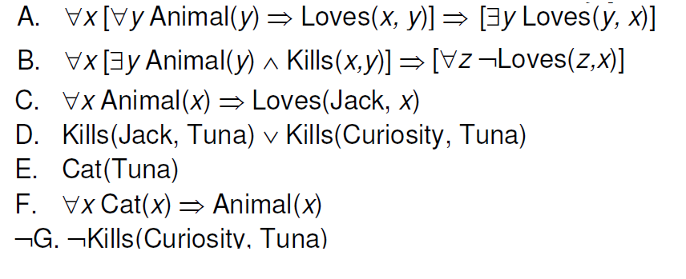

Slide 61
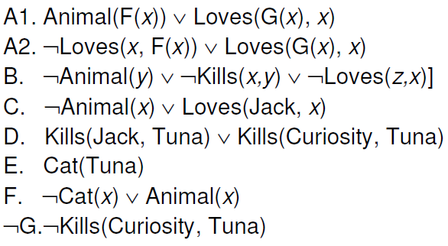
Notes:
To get A1, A2. a) skolemize first existential quantifier in consequen using G(x). Then negate implication, gives me existential in antecedent. Skolemize using f(x). Now I have conjunction from antecedent or consequent, distribute conjunction.

Slide 62
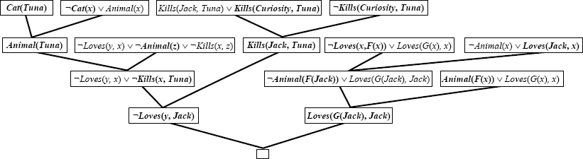
Resolution-based Inference
Notes:
Left half: just regular without skolem, basically says that if Jack did kill Tuna, then nobody loves jack.
Right side: use unification x:=jack on left, x := F(jack) on right.

Slide 63
Summary
Basic FOL inference algorithm (satisfiability check).
Use Skolemization to eliminate quantifiers
  Only universal quantifiers remain.
Convert to clausal form.
Use resolution + unification.
This algorithm is complete (Gödel 1929).

Slide 64
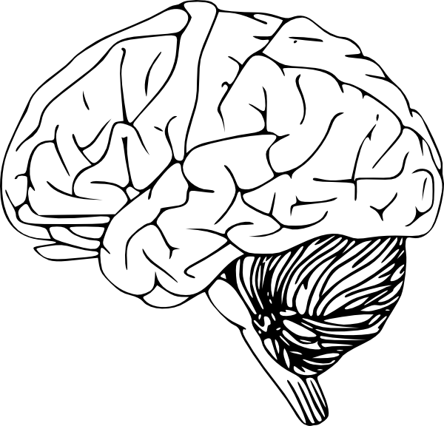
Expressiveness vs. Tractability
There is a fundamental trade-off between expressiveness and tractability in Artificial Intelligence.
Similar, even more difficult issues with probabilistic reasoning (later).
Reasoning power
Horn clause
Prolog
Description Logic
FOL
????
Valiant
expressiveness

Slide 65
Summary
Inference in FOL
  Grounding approach: reduce all sentences to PL and apply propositional inference techniques.
FOL/Lifted inference techniques
  Propositional techniques + Unification.
  Generalized Modus Ponens
  Resolution-based inference.
Many other aspects of FOL inference we did not discuss in class

